Slide 1

SDG&E 2014 All Source
RFO Bidder’s
Conference
First of three
2nd conference: 10/24 (conf call / Webinar only),
3rd conference - EE, DR and Energy Storage only: 11/10
Auditorium 1-3
Sempra Energy Corporate Center
101 Ash Street
San Diego, CA 92101
By Phone: Call-in (866) 256-9295
Pass Code: 1645061
Audience link: https://engage.vevent.com/rt/sempra/index.jsp?seid=53
September 26, 2014
Estimated time:
9:30 am to 3:00 pm
Updated / corrected as of: 9/29/2014
Notes:
Over the next 20 minutes, I will provide you an update on SDG&E, briefing you on some of the key issues facing our company, and then focusing on our strategic plan going forward
As you leave here today, I want to make sure you come away with 3 key takeaways for SDG&E
First, we realize that managing the costs charged to our customers is an integral component of our strategy and I will provide you an update of what we’ve achieved thus far and where we believe we are headed in the areas of electric rate reform and cost management
Second, the capital investments we’ve made in the past lay the foundation for our capital growth going forward, and I will review with you the key projects in our 5-year plan
As I will explain further, the composition of our capital investments and ratebase is changing from what you’ve seen in the past, focusing on investments consistent with the energy policies put forward by the State of California as Dennis and I outlined for you earlier
Finally, we are excited about the opportunities for further investment that are not in the current plan and I’ll discuss how we plan to leverage our existing investments to make this potential upside happen
We believe our strategic plan to address the challenges going forward, combined with our management team’s proven track record of success in operating excellence, creates new opportunities for us to continue delivering excellent value for both our customers and shareholders

Slide 2
Agenda

Slide 3
Safety Moment
Emergency Evacuation Plan overview
Logistics
  Restrooms
  Continental Breakfast and a light lunch will be provided
  Housekeeping questions?

Slide 4
General Q&A Guidance
SDG&E has posted (and will continue to post) questions and answers on the All Source solicitation website (http://www.sdge.com/all-source-2014-rfo)
  Q&A’s that apply to all product types are included on the main page; product type specific Q&As will be included on the page for each product type
Questions from today will be written down; all questions and answers will be posted on the RFO website
Questions can be submitted to AllSourceRFO@semprautilities.com at any time until the question submittal deadline
Questions received (and answers) will be posted to the website periodically
Deadline to submit questions: November 14, 2014
  SDG&E will post the final set of answers no later than December 1, 2014 (offers are due on January 5, 2015)

Slide 5
Legal Disclaimers: Anti-Trust Guidelines & Document Conflict
Anti-trust:
All participants in today’s meeting shall comply with anti-trust guidelines. These guidelines direct meeting participants to avoid discussions of topics or behavior that would result in anti-competitive behavior, including restraint of trade and conspiracy to create unfair or deceptive business practices or discrimination, allocation of production, imposition of boycotts and exclusive dealing arrangements
Document Conflict:
This presentation is intended to be a summary level discussion of the information and requirements established in the 2014 All Source RFO Materials. To the extent that there are any inconsistencies between the information provided in this presentation and the requirements in the RFO Materials, the RFO Materials shall govern
SDG&E 2014 All Source RFO - Bidders Conference

Slide 6
Welcome
Victor Vilaplana
VP, Electric & Fuel Procurement
June 2014 RAM RFO: Bringing Renewable Energy to San Diego

Slide 7
Major Sources of Local Power
Trabuco
Four 230 kV lines to SCE
Capistrano
Margarita
Laguna
Niguel
Cristianitos
RIVERSIDE CO.
Talega
Pala
SAN DIEGO CO.
Borrego
SAN ONOFRE
NUCLEAR POWER PLANT
Monserate
Wellhead
Escondido
Rincon
San Luis Rey
Lilac
Warners
Narrows
Calpeak
Peaker
Valley
Center
ENCINA
POWER PLANT
Ash
Escondido
Santa Ysabel
Esco
Lake Hodges
Palomar Energy
Poway
Pomerado
Boulder Creek
Penasquitos
Creelman
Sycamore
Canyon
Descanso
MEF
Los
Coches
Alpine
Suncrest
Substation
SRPL
El Cajon
Glencliff
Kumeyaay
Ocotillo
Mission
Loveland
Old Town
Calpeak
Peaker
Crestwood
Main Street
Miguel
SWPL
Barrett
Cameron
Boulevard
Otay
Border00
To North Gila
Substation
Arizona
Otay Lake
ECO
IMPERIAL VALLEY
MEXICO

Slide 8
SDG&E and Supplier Diversity
Bruce Mayberry
Senior DBE Advisor
http://www.sempra.com/about/supplier-diversity
June 2014 RAM RFO: Bringing Renewable Energy to San Diego

Slide 9
Diverse Supplier Initiative
General Order (GO) 156:
Adopted by the California Public Utilities Commission in 1986
Promote greater competition among utility suppliers by expanding the available supplier base and to encourage greater economic opportunity for women, minority, and disabled veteran owned businesses who have been historically left out of utility procurement
Fast Forward to 2014 at SDG&E:
“Advancing supplier diversity is more than just a priority for San Diego Gas & Electric® (SDG&E®); it’s become part of our company’s DNA.” – Jessie Knight, former CEO, SDG&E
Supplier diversity goals are part of our compensation goals
45% of our procurement dollars are being spent with diverse business enterprises (DBEs)

Slide 10
New GO 156 Electric Procurement Requirements
Starting in 2012, Utilities were required to add separate reporting on electrical procurement spends
The California IOUs developed standard reporting formats and definitions with the CPUC
The IOUs continue their outreach efforts with DBE firms in all markets –conventional, renewable, capacity and other products including those that are being solicited in this RFO

Slide 11
Supplier Diversity Certification*
Minority- or woman-owned company
California Public Utilities Commission (CPUC) Supplier Clearinghouse (free)
Service Disabled Veteran Business
State of California, General Services Office of Small and Disabled Veteran Business (OSDC)
NMSDC
Regional affiliates of the National Minority Supplier Development Council (NMSDC)
Others
Small Business Administration 8(a) (SBA)
Women Business Enterprise Council (WBEC-WEST)
State and municipal government agencies
*Certification does not guarantee any business enterprise the right to bid or receive a contract.

Slide 12
Supplier Diversity Contact Information
Bruce Mayberry
DBE Program Manager
BMayberry@semprautilities.com
858-654-8772
Brad Mantz
Energy Contracts Originator & E&FP Diversity Lead
emantz@semprautilities.com
858-654-1588

Slide 13
Role of the
Independent Evaluator
Barbara Sands
PA Consulting
June 2014 RAM RFO: Bringing Renewable Energy to San Diego

Slide 14
Independent Evaluator Introduction and Role
Jonathan Jacobs and Barbara Sands of PA Consulting Group will be the Independent Evaluators (“IEs”) for this solicitation. Both Jonathan and Barbara have been the IE for previous SDG&E’s RFOs (e.g., RPS, RAM, all-source RFO and peaking capacity RFO)
The role of the IE is to ensure that SDG&E’s evaluation of bids is transparent and that all bidders are treated fairly and equitably
The IE is expected to assure that affiliate and utility owned bids are not favored
The IE oversees SDG&E’s Cost Development Team and Evaluation Team
The IE will also ensure that bid compliance decisions are fair
The IE oversees the modeling of the bids including how each bid is represented the models
The IE provides advice to SDG&E on evaluation issues as they arise

Slide 15
RFO Need / Schedule / General Conformance Requirements
Pat Charles
E&FP Origination Analytics Manager
http://www.sdge.com/all-source-2014-rfo
June 2014 RAM RFO: Bringing Renewable Energy to San Diego

Slide 16
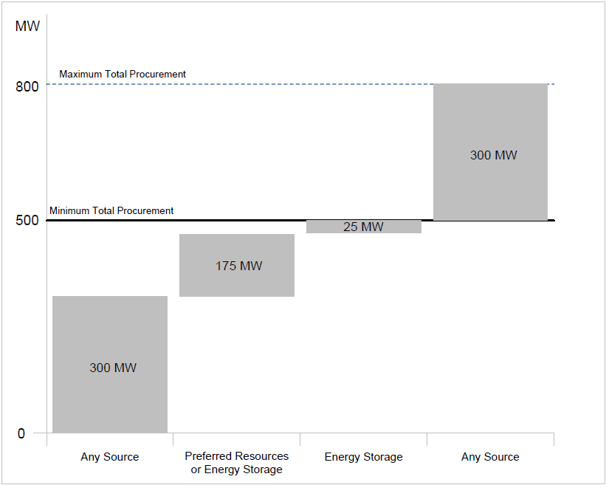
RFO Need
SDG&E is authorized to procure:
Up to 800MW of energy storage
Up to 775MW of preferred resources (not including energy storage)
Up to 600 MW from ‘any source’, such as conventional resources, or
Some combination thereof totaling up to 800 MW
SDG&E has separately requested Commission approval for the Carlsbad Energy Center (A.14-07-009)
If approved, 600 MW of SDG&E’s need will be filled by this contract
SDG&E is soliciting:
Third party-owned, contracted resources for all product types (EE, DR, Renewables, CHP, DG, Energy Storage and Conventional)
In addition, SDG&E is soliciting energy storage systems to be owned by SDG&E

Slide 17
RFO Schedule

Slide 18
RFO Schedule

Slide 19
RFO Conformance Requirements
This solicitation is for Local Capacity Requirements (LCR) as authorized in the Track 4 Decision (D.14-03-004)
4 main conformance requirements for all resource types:
Location
Resources must be located / must interconnect within the Local San Diego Subarea
For programs, customers enrolled must be located within SDG&E’s service territory
Resource Adequacy
The resource must qualify to count for RA / meet the RA counting rules / provide ‘RA Value’ (energy efficiency / load modifying DR)
Incremental
The resource must be ‘demonstrably incremental’ to the assumptions used in the CAISO studies done that underlie the 500 – 800 MW authorization
Contract Term
SDG&E will consider all contract terms
SDG&E does have preferences
some portion of contract term MUST encompass 2022

Slide 20
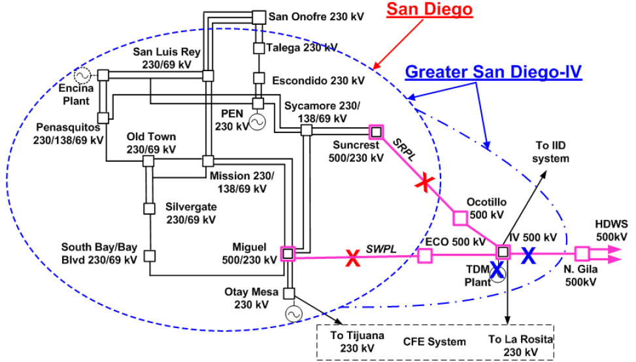
RFO Conformance Requirements - Location
‘San Diego Local subarea projects are those located in SDG&E’s service territory connecting to SDG&E owned transmission or distribution facilities at a point that is at or electrically west of the Miguel or Suncrest substations and electrically south of the San Onofre Nuclear Generating Station 230 kV switchyard.’
Diagram source: http://www.caiso.com/informed/Pages/StakeholderProcesses/LocalCapacityRequirementsProcess.aspx
See “Presentation – Final 2015 and 2019 Local Capacity Requirement San Diego Local Area”, pg 14

Slide 21
RFO Conformance Requirements – Resource Adequacy (RA)
IOUs must meet CPUC RA requirements on a monthly basis.
  RA resources used to meet these requirements have a ‘must offer obligation’ in the CAISO energy markets
The resources that SDG&E is seeking through this All Source RFO are intended to count toward SDG&E’s RA obligations or are required to provide RA value
More information is available from the CAISO and the CPUC websites
    For example, please see the CAISO Tariff, Secion 40 - http://www.caiso.com/Documents/Section40_ResourceAdequacyDemonstrationForAllSCsInTheCAISOBAA_May1_2014.pdf and the annual CPUC decisions governing the RA program: 2011 RA Requirements: D10-06-036, 2012: D11-06-022, 2013: D12-06-025, 2014: D13-06-024, 2015: D14-06-050
Generation or energy storage resources
must go through the CAISO deliverability study process and receive a non-energy only deliverability status
Use limited resources (such as DR programs or energy storage)
must be capable of operating / being dispatched for 4 hours on 3 consecutive days
EE and load-modifying DR
provide RA value by lowering the RA requirement (by reducing load)

Slide 22
RFO Conformance Requirements – “…demonstrably incremental…”
The Track 4 decision, OP 6 , requires that SDG&E observe the requirements listed in OP 4 of D.13-02-015 – the Track 1 decision
OP 4, b. “The resource must be demonstrably incremental to the assumptions used in the CAISO studies, to ensure that a given resource is not double counted.”
CAISO studies for track 4 were ordered via a revised scoping ruling issued 5/21/2013, available here: http://docs.cpuc.ca.gov/PublishedDocs/Efile/G000/M065/K202/65202525.PDF
Attachment A to the revised scoping ruling includes the Track 4 study assumptions
The CAISO study is more fully explained and the results are presented in the testimony of Mr. Robert Sparks, available at: http://www.caiso.com/Documents/Aug5_2013_Track_4_Testimony_RobertSparks_R12-03-014.pdf
See tables on following slides for additional resources

Slide 23
RFO Conformance Requirements – “…demonstrably incremental…”

Slide 24
RFO Conformance Requirements – “…demonstrably incremental…”

Slide 25
RFO Conformance Requirements – limit on Number of Offers
SDG&E is seeking a reasonable limit on the number offers
For ESSEPC, DR and EE respondents, six offers is the limit
For other respondents, limit is six mutually inclusive offers (i.e.: 6 packages or 6 option combinations)
Examples:
25 location ESSBOT offer, phased installations over a period of 4 years with 6 pricing combinations depending on on-line date – Acceptable
25 location ESSBOT offer, phased installations over a period of 4 years with 10 pricing combinations depending on on-line date – NOT Acceptable (SDG&E would ask the respondent to identify which 6 of the 10 pricing combinations to evaluate)
10 location ESSEPC offer, phased installations over 4 years with 2 pricing combinations – Acceptable
Each ‘package’ of projects (or ‘option combinations’) would constitute a mutually inclusive offer
Multiple combinations of project attributes/locations are allowed

Slide 26
Product Type Resource Criterial and Eligibility Requirements (EE and DR)

Slide 27
Product Type Resource Criterial and Eligibility Requirements

Slide 28
Overview of Bidding Protocol
Maria Boldyreva
Origination Advisor
Scot Rolfe
Principal Business Analyst
June 2014 RAM RFO: Bringing Renewable Energy to San Diego

Slide 29
RFO Documentation Requirements

Slide 30
Offer Form Overview
Excel-based offer(bid) forms
Spreadsheets are protected(locked) so only data entry fields should be editable
DO NOT try to add rows, columns, sheets, or in any way change the layout of your offer form
If you find any errors, or have any problems using the offer forms, please contact us at allsourceRFO@semprautilities.com immediately

Slide 31
Offer Form Sections by Resource
 | Sheet Names
Resource Type | Instructions | Bidder/Contact Information | Program/Project Description | Capacity and/or Price | Typical Profile | Operational Constraints | Variable Costs | Other Resource Specific Sheets
Conventional | X | X | X | X |  | X | X
Renewable | X | X | X | X | X
DR | X | X | X
EE | X | X | X | X
CHP | X | X | X | X | X |  |  | X
Storage | X | X | X | X |  | X |  | X
DG | X | X | X

Slide 32
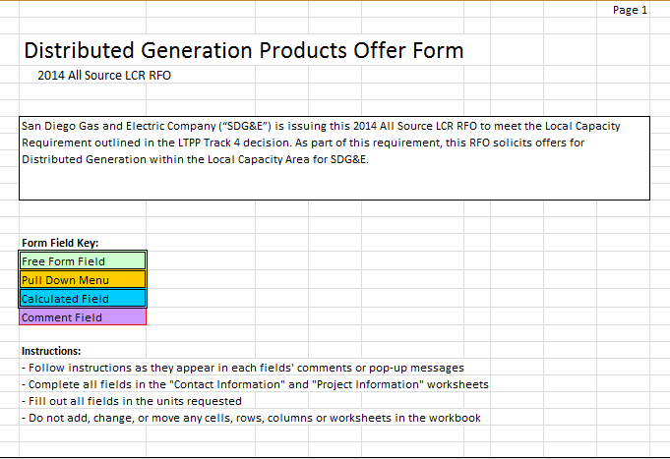
Instruction Sheet and Form Color Key
SDG&E 2014 All Source RFO - Bidders Conference

Slide 33
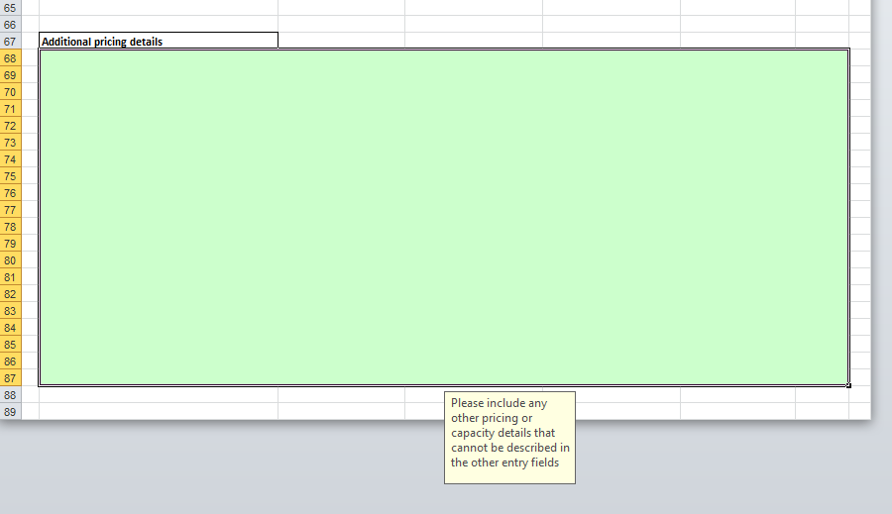
Offer Forms
Fill out EVERY applicable field. Failure to do so could result in non-conformance
Abundant free-form fields to describe any aspects of your project/program that don’t fit exactly within our entry fields, please use them
SDG&E 2014 All Source RFO - Bidders Conference

Slide 34
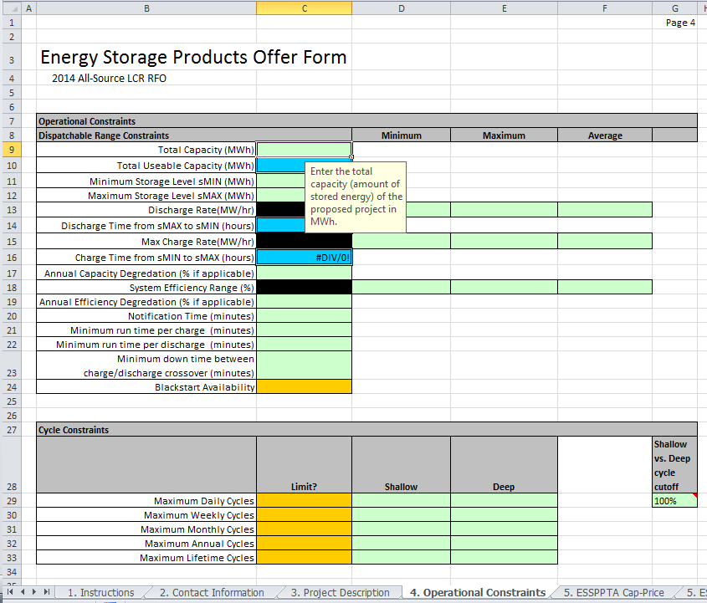
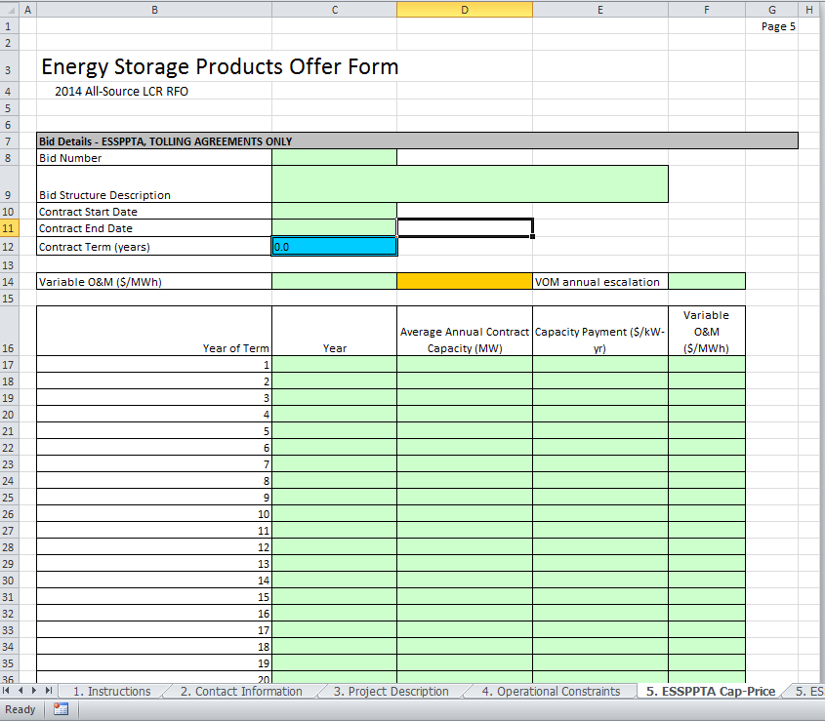
Offer Forms
SDG&E 2014 All Source RFO - Bidders Conference

Slide 35
Bid Submission Process
Leilan Johnson
Origination Analyst
Maria Boldyreva
Origination Advisor
June 2014 RAM RFO: Bringing Renewable Energy to San Diego

Slide 36
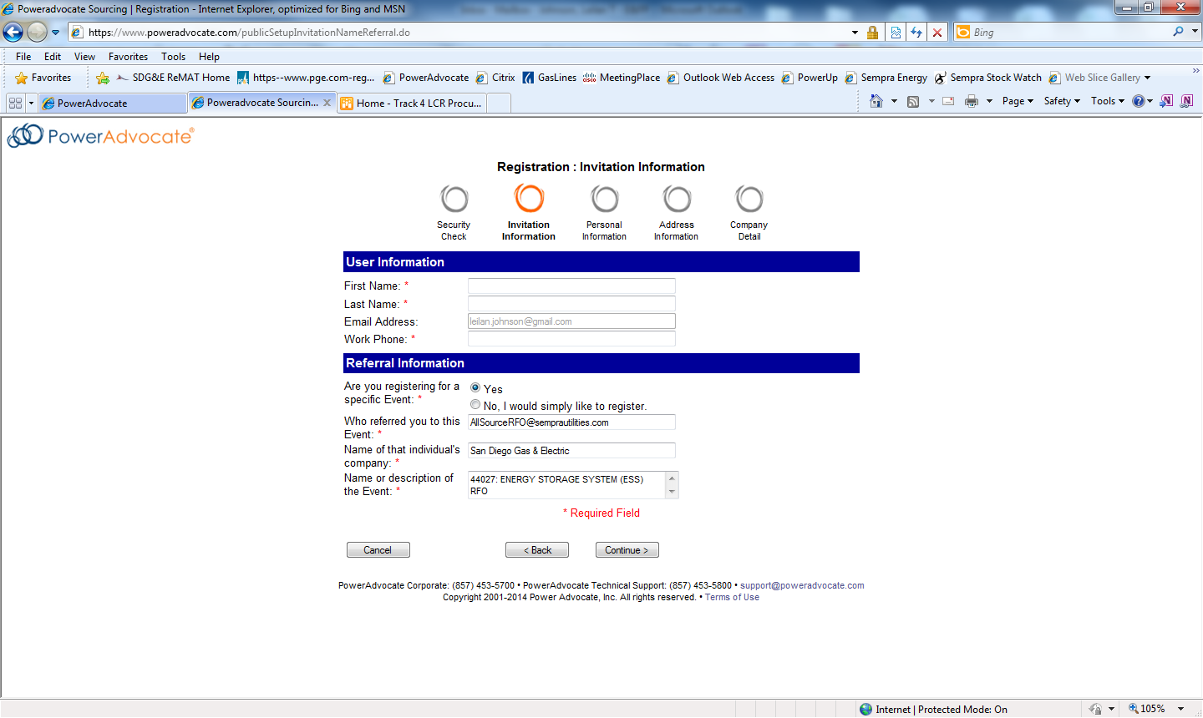
Registration and Logging On
Ways to Register:
  Receive an invitational email from SDG&E followed by a link to access PowerAdvocate®
  Register as a first-time user on www.PowerAdvocate.com
    Request for access using the Referral Information
  Request for access using the PowerAdvocate® link provided in the RFO documents
How to Log On:
Launch a web browser and go to: www.poweradvocate.com, and then click on the orange Login button
Enter your account User Name and Password (both are case-sensitive)
Click Login

Slide 37
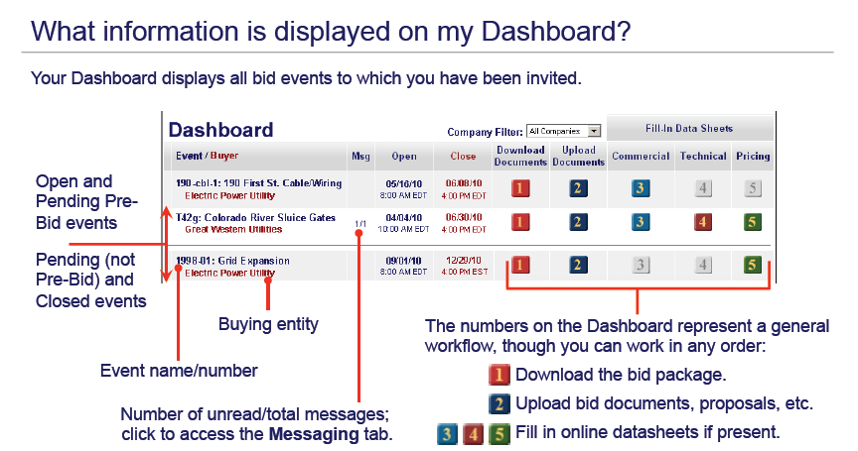
The Supplier Dashboard

Slide 38
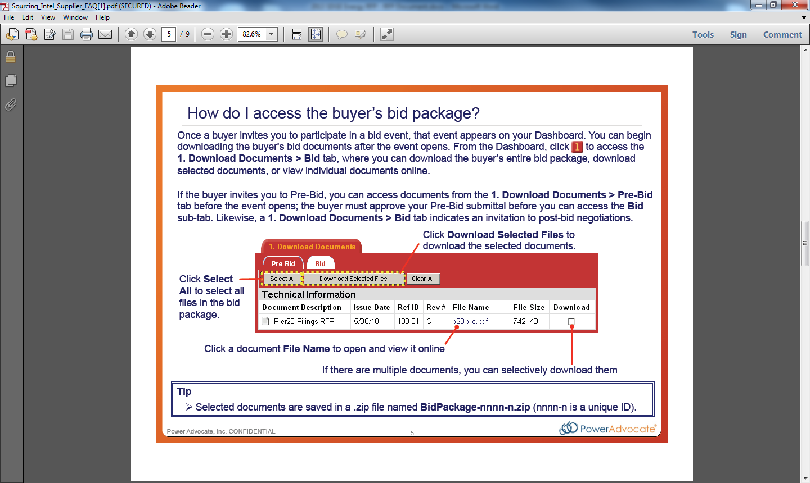
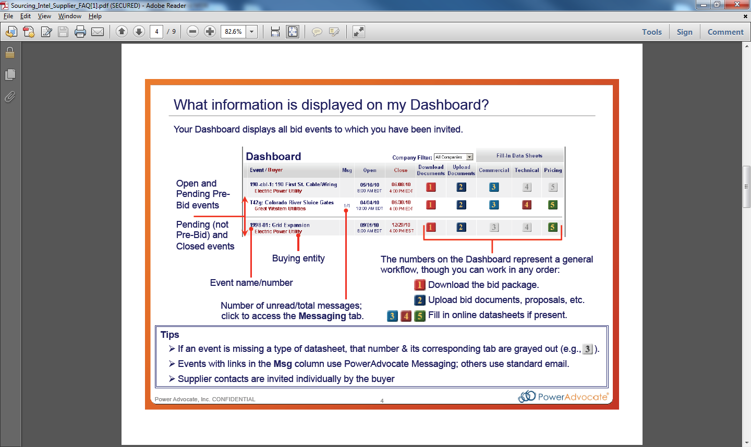
Accessing the RFP Event and Submitting Documents
How to Access the RFP Event from Dashboard:
To download the RFP package, click or select the 1. Download Documents tab
  RFO Document
  Project Description
  Pricing/Offer Form
  Credit Application
  PPA Document
  Other forms
To upload documents, click or select the 2. Upload Documents tab. Select the “Commercial and Administration” Document Type, then click Browse to navigate to your document and click Open. Finally, click Submit Document
  Project Description Form (.doc or .docx)
  Pricing Form (.xls or .xlsx)
  Interconnection Documents (.pdf)
  Site Control Documentation (.pdf)

Slide 39
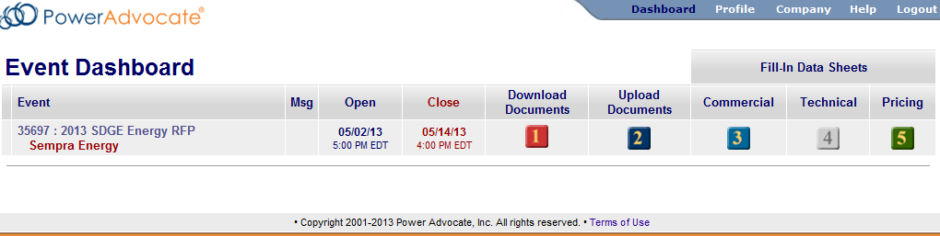
More Information & Additional Help
PowerAdvocate Support
  Support@poweradvocate.com
  (857) 453-5800
Online Help
  Access the Help System at any time by clicking on the Help button
SDG&E 2014 All Source RFO - Bidders Conference

Slide 40
Top Eight Mistakes
8. Inconsistent contract terms between worksheets
Prices and deliveries should start at the same date as the contract start date. Deliveries and prices should stop in the final contract year. Pricing forms for contracts of 15 year terms that only have 10 years of pricing and deliveries, or any other mismatch that is not explained in the pricing form, may be declared non-conforming and rejected
7. No specific project location
At the very least, a bid must have a fixed physical location. Entering vague information such as “Anywhere in Southern California” or “Any location in conformance with CEC regulatory guidelines and California Public Utilities Code” will result in the bid being declared non-conforming and rejected. Does not apply to ESSEPC.
6. Using incorrect units
Offer form entries that are inconsistent with the units shown at the top of the pricing form column may require corrections. For example: $/MWh vs. cents/kWh
SDG&E 2014 All Source RFO - Bidders Conference
SDG&E 2014 All Source RFO - Bidders Conference
2013 Renewables RFO: Bringing Renewable Energy to San Diego

Slide 41
Top Eight Mistakes
5. Bidding DC capacity and energy instead of AC capacity and energy
Important for solar PV developers. Utilities do not sell DC electricity to retail customers. Bidding DC megawatts and megawatt-hours will cause inaccurate contract evaluations, and such bids may be declared non-conforming and rejected
4. Adding or renaming worksheets
If the bid has multiple options for pricing/COD/deliveries/etc., fill out separate pricing forms for each option. Adding worksheets, or renaming worksheets, create problems with interpretation and processing, and the bid may be declared non-conforming and rejected
3. Wrong project technology
Make sure that the Project Information form describes the technology as “Solar PV” if it is solar photovoltaics, “Wind “ if the project is wind, etc. For projects that are a combination of technologies, enter “Hybrid”
2. Pricing form data inconsistent with project description form
The Project Description Form and the Pricing Forms should describe the same project and pricing options. If options are submitted that are inconsistent with the Project Description Form, the options may be declared non-conforming and rejected. If none of the submitted pricing forms match the Project Description Form, the entire bid may be rejected
SDG&E 2014 All Source RFO - Bidders Conference
2013 Renewables RFO: Bringing Renewable Energy to San Diego

Slide 42
Top Eight Mistakes
1. Making the utility fill out your bid form
Bidders must be evaluated fairly, and the utility must demonstrate that bidders have been treated equally in an RFO. Creating ambiguities in a pricing form that forces the utility to “fill out” critical sections, either as additions or corrections, is not only a time-consuming process that can lead to inaccuracies, but can also be construed as special treatment of bidders, creating conflict of interest and jeopardizing the integrity of the RFO process
If you have made mistakes in your pricing forms, you can notify us by email (allsourcerfo@semprautilities.com), but you must make the corrections yourselves and submit them separately, with a notice to us that the revised form replaces the form previously submitted. Please include the name of the form to be replaced and the date of the original submission. All corrections must be submitted before the bid closing deadline. Failure to submit corrected bid forms may result in a bid being declared non-conforming and rejected
SDG&E 2014 All Source RFO - Bidders Conference
2013 Renewables RFO: Bringing Renewable Energy to San Diego

Slide 43
Please submit your questions by
November 14, 2014
to
AllSourceRFO@SempraUtilities.com
June 2014 RAM RFO: Bringing Renewable Energy to San Diego

Slide 44
Break - Lunch

Slide 45
RFO Evaluation Overview
Scot Rolfe
Principal Business Analyst

Slide 46
RFO Evaluation Topics
Valuation and Selection Process
  Least-Cost/Best-Fit (LCBF)
Quantitative Evaluation
  Net Market Value (NMV)
  Each conforming offer is valued using this discounted cash flow analysis
Qualitative Evaluation
  Used to differentiate similarly valued offers
Shortlisted Offers

Slide 47
Quantitative Valuation Process: NMV
Benefits
Costs
Net Market Value

Slide 48
NMV: Typical Benefits and Costs
Typical Benefits |  | Typical Costs
Energy |  | Contract Payments
Ancillary Services (A/S) |  | Variable Energy Costs (Fuel, VOM, GHG Compliance)
Capacity (RA) |  | Transmission Interconnection
Renewable Energy Credits (REC’s)

Slide 49
High-Level Overview, Quantitative Valuation Process
Price Forecasts: Capacity (RA)
Capacity Benefit, Contract Cost, IC Cost
Contract / Program Costs.
Interconnection Costs
Optimized Energy Dispatch
Price Forecasts
Energy Dispatch Benefits and Costs
Variable Dispatch Costs.
Resource Characteristics/Constraints
Discounted Sum =
NMV

Slide 50
NMV: Optimized Dispatch
Must-Take Resources (Non-Dispatchable)
  Expected generation profile valued against energy forward price curves
Dispatchable Resources
  Conventional and Storage Resources modeled with dispatch optimization models valuing resource operating characteristics against energy forward price curves

Slide 51
NMV: Market Price Forecasting
Energy Price
  Market Based Forecast, SP15
A/S Prices
  Spin, Non-spin, regulation
Natural Gas Prices
  Market Based Forecast, SoCal Delivered
GHG Allowances
  Market Based Forecast

Slide 52
Qualitative Evaluation
Criteria may be considered in the Qualitative Evaluation:
Project development status:
  Electrical interconnection status
  Permitting status
  Fuel and water interconnections
  Site control
Developer attributes
  Project financing
  Development experience
  Project viability
Diverse Business Enterprise (“DBE”) status
Loading Order Ranking
Other attributes
  Contribution to other procurement targets (CHP, RPS, Energy Storage)
  Non-quantifiable flexibility and curtailment options
  Portfolio fit (Capacity, energy, term, etc.)
  Technology risk

Slide 53
Contractual Requirements -
PPA Terms and Credit Requirements
Remi Raphael
Quantitative Risk & Controls Manager
Tom Saile
Energy Contracts Originator
June 2014 RAM RFO: Bringing Renewable Energy to San Diego

Slide 54
Initial Collateral Requirement
Initial Collateral Requirement is the amount of SDG&E’s exposure, at the time of the execution of the transaction, to the Seller’s default or non-performance
Held constant throughout the term of the contracts
Ongoing Collateral requirement is based on Mark to Market basis (may vary by product type)
May change subject to changes in market data
Initial and on-going Collateral requirements can be satisfied by the combination of:
Unsecured Credit: granted by SDG&E to the Seller based on credit worthiness (credit application)
Secured Credit: Cash posted by the Seller or letter of credit posted by the Seller
SDG&E 2014 All Source RFO - Bidders Conference

Slide 55
Ongoing Collateral requirement
A positive Current Mark-to-Market Value implies Buyer has the potential for realization of market gains and thus has exposure to Seller’s default or non-performance
Throughout the term of the contract, the Current Mark-to-Market (MtM) value is calculated based on market data (forward prices, volatilities, correlations, penalties, replacement cost, etc.) and by taking the sum of the positive exposure for each remaining full month in the Term of the Transaction
The requirement to post additional collateral to satisfy ongoing collateral requirement will follow a standard margining model, set up for one-way margining (Buyer margining the Seller)
Calculation of mark to market may vary by product type (EE, DR, Renewables, CHP, DG, Conventional, Energy Storage)
SDG&E 2014 All Source RFO - Bidders Conference

Slide 56
Overview of Credit Application
General Information
Legal Company Name
Doing Business As (DBA)
___________________________________________________________________________________________________________
Credit Support Provider (Legal company name of Guarantor)
Street Address City State Zip Code
Federal Tax ID #
Organized & existing under the laws of: (State) Year Incorporated/Established
Primary Contacts:
Credit Issues Contact:
Name Title Phone FAX E-Mail
Business Issues Contact:
Name Title Phone FAX E-Mail
Please provide the following information with this application:
Most recent three (3) fiscal years’, CPA-audited, financial statements including notes to the financial statements.
When using a credit support provider, include most recent three (3) fiscal years’, CPA-audited, financial statements of the credit support provider.
No need to attach financial statements when they are available on the web, provide address:____________________________________

Slide 57
PPA Overview
SDG&E 2014 All Source RFO - Bidders Conference

Slide 58
PPA Overview - Continued
SDG&E 2014 All Source RFO - Bidders Conference

Slide 59
EE / DR Programs Breakout (E3 Calculator training)

Slide 60
Interconnection Overview
Michael Iammarino
Customer Generation/Principle Business Analyst
Bruno Velosa
Electric System Planning/Team Lead
June 2014 RAM RFO: Bringing Renewable Energy to San Diego

Slide 61
Distribution System Interconnection Processes
Distribution Interconnections
SDG&E’s distribution voltage is defined as facilities operating at 12.47 kV LL or below
All interconnection requests (IR) applications must be submitted to SDG&E’s Customer Generation group
  IR - All Applicants (Rule 21 and WDAT)
    Completed and valid Interconnection Request
    $800 interconnection request fee
    Site exclusivity documentation
Rule 21
  Governed by CPUC
Wholesale Distribution Open Access Tariff (WDAT)
  Governed by FERC
SDG&E 2014 All Source RFO - Bidders Conference

Slide 62
SDG&E’s Rule 21 –Interconnection Process
Used for Net Metering Systems, Self Served Load and CPUC Wholesale export program projects
Primary Components:
  Pre-Application Report (option)
  Fast Track Review Process
    Simplified Interconnection
    Initial/Supplemental Reviews
  Detailed Study Process
    Independent Study
    Group Study
SDG&E 2014 All Source RFO - Bidders Conference

Slide 63
Rule 21 Highlights
Single Rule 21/WDAT interconnection queue
Pre-Application Report option - $300 fee
Fast Track review process for projects ≤ 1.5 MW
$800 non-refundable IR fee; $2500 Supp. Review fee
Detailed Study Process-Independent/Group Study
Clearly defined Study Timelines
Financial Security must be posted (Detailed Study)
Proof of Site Control/Site Exclusivity required
Formal Dispute Resolution Process
  SDG&E Ombudsman: initial point of contact for disputes
SDG&E 2014 All Source RFO - Bidders Conference

Slide 64
Rule 21 Review Process
Pre-Application Report
  High level feasibility review
  Performed with readily available information; no studies
  10 BD completion from valid request
Fast Track Process – Screening Process
  Initial Review (13 screens) – 15 BD from receipt of valid IR
    Pass Initial Review:
      Upgrades Required - Cost Estimates; Draft Generator Interconnection Agreement (GIA)
      No Upgrades Required – Draft GIA
    Fail Initial Review: Request Supplemental Review/Withdraw IR
  Supplemental Review (3 add’l screens) - 20 BD from receipt of add’l information
    Pass Supplemental Review:
      Upgrades Required - Cost Estimates; Draft Generator Interconnection Agreement (GIA)
      No Upgrades Required – Draft GIA
    Fail Supplemental Review: Request Detailed Study/Withdraw IR
SDG&E 2014 All Source RFO - Bidders Conference

Slide 65
Rule 21 Detailed Study Process
Applicability
  Failed Fast Track Process; $10,000 study deposit
  Projects: >1.5 MWs ≤ 5 MWs; $10,000 study deposit
  > 5 MWs; $50,000 study deposit + $1000/MW
Electrical Independence Tests
  Transmission System – Screen Q
    Pass – Electrical Independence Test for Distribution System
    Fail – Transmission Cluster Study (WDAT)
  Distribution System – Screen R
    Pass – Independent Study Process
    Fail – Distribution Group Study Process
SDG&E 2014 All Source RFO - Bidders Conference

Slide 66
Rule 21 Detailed Study Process – Continued
Independent Study Process - Includes: 1) Interconnection System Impact Study (SIS) and 2) Interconnection System Facilities Study (IFS)
  Interconnection System Impact Study
    Scoping Meeting Scheduled (5 BD after passing Screens Q & R)
    Provide Detailed Study Agreement (DSA) to Applicant (15 BD)
    Commence SIS from receipt of DSA from Applicant (30 BD)
    Final SIS report (60 BD to completion)
    Schedule Results Meeting if requested by applicant – (10 BD from SIS report)
    Tender Draft GIA (assumes IFS waived).
    Post financial security as required
  Interconnection System Facilities Study (if required)
    ≤ 5 MW: Requires additional $15,000 deposit; additional information
    Commence IFS, issue final report (60 BD if upgrades/45 BD no upgrades)
    Schedule Results Meeting if requested by applicant (5 BD - from request)
    Tender Draft GIA (30 CD - from 3) above)
    Post financial security as required
SDG&E 2014 All Source RFO - Bidders Conference

Slide 67
Rule 21 Detailed Study Process – Continued
Distribution Group Study Process - Includes:1) Phase l Interconnection Study and Phase ll Interconnection Study
  Phase l Interconnection Study (Phase l)
    Applicant must send notification to participate to SDG&E prior to close of study window;
    2 study windows annually: March and September
    Scoping Meeting Scheduled (5 BD - after Elec. Independence Test)
    Provide Detailed Study Agreement (DSA) to Applicant (15 BD)
    Conduct Phase l study and issue final study results report (60 BD from start of study)
    Results meeting upon Applicant request (optional; 5 BD to schedule meeting)
    Tender Draft GIA (30 CD after results meeting assumes Phase Study ll waived).
    Post financial security as required
  Phase ll Interconnection Study (Phase ll) (if required)
    ≤ 5 MW: Requires additional $15,000 deposit; additional information
    Phase ll study begins (60 CD after Phase l final study results report)
    Final Phase ll study results report completed (60 BD from 1) above)
    Results meeting upon Applicant request (optional; 5 BD to schedule meeting)
    Tender Draft GIA (30 CD after results meeting)
    Post financial security as required
SDG&E 2014 All Source RFO - Bidders Conference

Slide 68
SDG&E’s WDAT– Interconnection Process
Primary Components:
  Pre-Application Report (option)
  Fast Track Review Process
    Simplified Interconnection
    Initial/Supplemental Reviews
  Detailed Study Process
    Independent Study
    Cluster Study
SDG&E 2014 All Source RFO - Bidders Conference

Slide 69
SDG&E’s WDAT Highlights
WDAT interconnection queue
Pre-Application Report option - $300 fee
Fast Track review process for projects ≤ 2 MW
$800 non-refundable IR fee
$500 processing fee and $1000 study fee
Independent Study/Cluster Study Process
Defined Study Timelines
Financial Security must be posted (Ind/Cluster Study)
Proof of Site Control/Site Exclusivity required
SDG&E 2014 All Source RFO - Bidders Conference

Slide 70
WDAT Review Process
Pre-Application Report
  High level feasibility review
  Performed with readily available information; no studies
  Timely completion from valid request
Fast Track Process – Screening Process
  Initial Review: Actual cost
  Initial Review (10 screens) – 15 BD from receipt of valid IR
    Pass Initial Review:
      Tender Draft Generator Interconnection Agreement (GIA) – 15 BD
    Fail Initial Review: Request Supplemental Review/Withdraw IR
  Supplemental Review - 20 BD from receipt of add’l information
    Pass Supplemental Review:
      Tender Draft Generator Interconnection Agreement (GIA) – 15 BD
    Fail Supplemental Review: Request Independent/Cluster Study or Withdraw IR
SDG&E 2014 All Source RFO - Bidders Conference

Slide 71
WDAT Independent/Cluster Study Process
Applicability
  Failed Fast Track Process; $10,000 study deposit
  Projects: >2 MWs ≤ 5 MWs; $10,000 study deposit
  > 5 MWs; $50,000 study deposit + $1000/MW
Electrical Independence Tests for CAISO Grid
  Transmission System
    Pass – Electrical Independence Test for Distribution System
    Fail – Transmission Cluster Study (WDAT)
  Distribution System
    Pass – Independent Study Process
    Fail – Cluster Study Process
SDG&E 2014 All Source RFO - Bidders Conference

Slide 72
WDAT Independent Process
Independent Study Process - Includes: 1) Interconnection System Impact Study (SIS) and 2) Interconnection Facilities Study (IFS)
  Interconnection System Impact Study
    Scoping Meeting Scheduled (10 BD after valid IR)
    Provide SIS Study Agreement to Applicant (15 BD after Scoping Meeting)
    Conduct SIS from receipt of SIS study agreement from Applicant (30 BD)
    Final SIS report (Timely completion)
    Schedule Results Meeting if requested by applicant – (10 BD from SIS report)
    Tender Draft GIA (assumes IFS waived).
    Post financial security as required
  Interconnection System Facilities Study (if required)
    ≤ 5 MW: Requires additional $15,000 deposit; additional information
    Conduct IFS, issue final report (Timely completion)
    Schedule Results Meeting if requested by applicant (5 BD - from request)
    Tender Draft GIA (30 Calendar Days (CD) from Results Meeting)
    Post financial security as required
SDG&E 2014 All Source RFO - Bidders Conference

Slide 73
WDAT Cluster Study Process
Cluster Study Process - Includes:1) Phase l Interconnection Study and Phase ll Interconnection Study
  Phase l Interconnection Study (Ph l)
    Applicant must send notification to participate to SDG&E prior to close of study window;
    2 study windows annually: April and October 15 – November 15
    Scoping Meeting Scheduled (10 BD – after receipt of valid IR)
    Provide Generator Interconnection Study Agreement (GISA) to Applicant (30 CD)
    Commence Ph l study June 1 issue final study results report (200 CD from start of study)
    Results meeting (30 CD to after issue of final Ph l report)
    Tender Draft GIA (30 CD after results meeting assumes Ph ll waived)
    Post financial security as required
  Phase ll Interconnection Study (Ph ll) (if required)
    ≤ 5 MW: Requires additional $15,000 deposit; additional information
    Commence Ph ll study by May 1 (60 CD after Ph l final study results report)
    Final Ph ll study results report completed (205 CD from start of study)
    Results meeting upon Applicant request (optional; 5 BD to schedule meeting)
    Tender Draft GIA (30 CD after Ph ll final report)
    Post financial security as required
SDG&E 2014 All Source RFO - Bidders Conference

Slide 74
Interconnection Process Contact Information
Ken Parks
Customer Generation Manager
8316 Century Park Court, CP52F
San Diego, CA 92123
Office: (858) 636-5581
www.sdge.com/nem
KParks@semprautilities.com
SDG&E 2014 All Source RFO - Bidders Conference

Slide 75
CAISO Generator Interconnection and Deliverability Allocation Procedures
Interconnection to SDG&E transmission system is governed by the CAISO’s FERC approved Tariff: CAISO Tariff Appendix DD (GIDAP tariff) applies to interconnection requests starting with Cluster 5http://www.caiso.com/Documents/AppendixDD_GeneratorInterconnectionAndDeliverabiltyAllocationProcess_Aug1_2014.pdf Cluster Windows: Cluster 8 - April 1 to April 30, 2015 GIDAP PROCESS (Approximately 20 Months)
Interconnection Request (IR)
Scoping Meeting
Project Grouping
Phase I Interconnection Study (170 days)
Phase II Interconnection Study (205 days)
Posting of Financial Security
Large/Small Generator Interconnection Agreements (LGIA/SGIA)
SDG&E 2014 All Source RFO - Bidders Conference

Slide 76
Cluster Study Windows and IR
During the Cluster Study Windows, Interconnection Customers (ICs) must submit a completed Interconnection Request (IR) and provide evidence to demonstrate Site Exclusivity (or an additional $250K for Large/$100K for Small deposit in lieu of Site Exclusivity)
A completed IR includes:
  IR form
  Point of Interconnection (POI)
  Technical Data (Attachment A, Appendix 1)
  Voltage Level
  Study Deposit - $50,000 plus $1,000 per MW ($250K max.)
  IC elects deliverability Full Capacity or Energy Only
SDG&E 2014 All Source RFO - Bidders Conference

Slide 77
Generation Interconnection Information
SDG&E Interconnection Website: http://www.sdge.com/generation-interconnections/overview-generation-interconnections
  Download and review SDG&E Interconnection Handbook
  Links to CAISO interconnection queue, tariffs and websites
  Links to SDG&E interconnection queue, tariffs and websites
  Link to NERC/WECC Reliability Standards
  Links to Process Summaries
  Link to SDG&E Self Generation Technologies site
SDG&E 2014 All Source RFO - Bidders Conference

Slide 78
Utility Owned Storage
Frank Thomas
Manager - Elect Project Dev Business Planning
June 2014 RAM RFO: Bringing Renewable Energy to San Diego

Slide 79
Utility Owned Energy Storage ~
Bid/Contract Requirements
Non-Disclosure Agreement
  Two-way for ESSEPC, ESSBOT per terms of RFP
Technical Specifications
  Required for all ESS utility ownership bids, possibly more stringent than ESSPPTA
Commercial Viability
  Must be commercially proven technology
Credit
ESSEPC Deposit Fee
  None will be required
Warranty and Capacity Guarantees per RFO
  Bidder to provide O&M pricing as part of bid, SDG&E to validate
O&M Contract
  Desired but not mandatory
  Desired for duration of warranty and/or capacity guarantees or longer

Slide 80
Utility Owned Energy Storage ~
Pre-Bid Schedule
October 1: Last Day for ESSEPC Bidder to submit expression of interest (include contact info to RFO email address)
October 3: SDG&E sends out executed non-disclosure agreement (NDA) to ESSEPCs
October 10: SDG&E provides IE w/commercial viability metrics
October 17: Last Day for ESSBOT Bidder to submit expression of interest, (include contact info to RFO email address)
October 15-17: ESSEPC ~ Receipt of bidder executed NDA, proposed technology, summary of existing installation capacity, location, and in-service duration, and 10 MW-4 hr energy density info (footprint, weight, height, clearances, efficiency rating) for its technology to RFO Mailbox

Slide 81
Utility Owned Energy Storage ~
Pre-Bid Schedule ~ Continued
October 20: SDG&E sends out technical specifications, minimum credit requirements, and commercial viability metrics to ESSEPC and ESSBOT
October 28: SDG&E notify ESSEPC bidder of technology acceptance
October 31: SDG&E sends out utility owned land information to ESSEPC
  Including buildable area, environmental limitations (if any), interconnection capacity limitations (if known), expected permitting complexity
October 31: ESSBOT submits proposed technology to RFO Mailbox
November 7: SDG&E notify ESSBOT bidder of technology acceptance
November 14: ESSEPC bidders identify proposed projects by property (submit to RFO Mailbox) to allow SDG&E to estimate interconnection and permitting cost.
December 1: ESSEPC conceptual design information submittal to RFO Mailbox
December 10: ESSBOT and ESSEPC bidders not seeking life duration O&M contract submit O&M costs to RFO Mailbox …Allows SDG&E to validate before bids due.

Slide 82
Utility Owned Energy Storage ~
ESSBOT vs. ESSEPC
ESSBOT same requirements as ESSEPC except:
  ESSBOT is complete turnkey,
  Asset ownership transfer after performance testing completed
If contracted, both will require and be bound by:
  Design Review and Factory Acceptance Tests
If contracted, both may require:
  Factory qualification survey for new manufacturing facilities

Slide 83
Utility Owned Energy Storage ~
Pre-Bid Bidder-SDG&E Interaction
Communication
  Utility owned questions by bidders and answers by SDG&E will be public to ESSBOT and ESSEPC bidders respectively
  SDG&E questions to bidders
    If to all, posted on Q&A website
    If to bidder, then electronically with IE copied on all communication
    Prior to bid submittal, no meetings or individual contact between SDG&E utility owned cost development team and bidder
Responsibilities
  ESSEPC: SDG&E lead on interconnection and permitting with pricing to be combined with ESSEPC bid. SDG&E responsible for cost and construction of interconnection from high side of step-up transformer.

Slide 84
Please submit your questions by
November 14, 2014
to
AllSourceRFO@SempraUtilities.com

Slide 85
General Q&A Session
and Networking
June 2014 RAM RFO: Bringing Renewable Energy to San Diego

